Slide 1
Raising Funds at PNC
Never write a check again!
Dawn Wrench
PNC Coordinator, WJHS-BPA
919-323-7751
schedulingpnc@gmail.com

Slide 2
PNC Information
PNC Arena is the home of the Carolina Hurricanes and NCSU Basketball
PNC contracts with volunteer organizations to staff food stands and food carts through it’s catering arm, VAB Catering
Groups are paid on a commission basis with the amount depending on sales volume
WJHS-BPA has adopted Stand 123, one of the top earning stands in the arena
Total amount paid to the WJHS-BPA for the 2019-2020 season (as of 4/7/20) – $34,835 with bonus money of $1,765 expected.

Slide 3
Benefits of Volunteering at PNC
Working consistently, you can earn enough to cover the fall and winter seasons (especially when paired with other fund raisers)
Once you have fulfilled your IE, you can use the money toward extra expenses for your child (shoes, meal plans, etc.)
Work at your convenience
Events are held every day of the week at various times throughout the season
Raise funds from a pool of people outside your network
Get to know your band family while having fun

Slide 4
Who Should Volunteer
EVERYONE
This program has brought over $580,150 to this band program since 2006
We are under contract to staff Stand 123 for 72 events a year; a breach of contract could result in the loss of this high volume stand
Even if you can pay your IE without fundraising, work at PNC to keep your own costs down and to help the overall band program

Slide 5
Requirements to Volunteer
Uniform; teal green golf shirt, black apron and ball cap (must be obtained through BPA), black pants and comfortable, non-slip black shoes
Apparel Can be purchased through westbandapparel.com
BARS (Be A Responsible Server) Training – required to work any event that serves alcohol (that is MOST events at PNC)
BARS training is offered several times at PNC in the fall
Students 16 and up may work as utility workers
Transportation – if you plan ahead you can carpool!
Ability to be on your feet 4-5 hours
Willingness to learn and have fun

Slide 6
Typical Event – What to Expect
Staff must arrive 1 hour and 15 minutes prior to the gates opening
Once checked in, volunteers go to the stand to begin inventory and stand preparation
Sales start when the gates open (items we sell include water, sodas, beer, hot dogs, chicken tenders, fries, peanuts, popcorn, nachos )
7 people work the stand at one time; 6 on registers and one lead/caller
End of shift; count down registers and clean stand
Typical hockey game shift begins at 4:45 p.m. and ends around 9:45

Slide 7
How We Earn $$
PNC pays based on sales commission (after taxes)
10% for food sales; 7% for beer
PNC mails payment to BPA
A hourly rate is determined based on the amount of commission divided by total number of hours worked by the staff
10% of individual earnings go to the BPA’s general fund; the rest is credited to your account
Potential average earnings for hockey/basketball games - $88 (guaranteed minimum of $40)
There is a 2% add on if you wish to be a lead, this person arrives early/stays late to take care of the money
Potential average earnings for concerts and special events - $100+

Slide 8
Example Calculations**
Example: total sales for hockey game are $2500 in alcohol and $4000 in food. Tax rate is 7.75%.
Commission on Alcohol Sales (7%)
$2500/(1.0775) = $2320.19
$2320.19 x (.07) = $162.41
Commission on Food (10%)
$4000/(1.0775) = $3712.30
$3712.30 x (.10) = $371.23
$162.41 + $371.23 = $533.64
** This is just an example. Commissions vary greatly, depending on the event.
Name | Hours | Total Earned | General Fund (10%) | IE Credit
Person 1 | 4.75 | 68.50 | 6.85 | 61.65
Person 2 | 5.25 | 75.71 | 7.57 | 68.14
Person 3 | 6.25 | 90.13 | 9.01 | 81.12
Person 4 | 5.00 | 77.10 | 7.71 | 69.39
Person 5 | 5.50 | 79.31 | 7.93 | 71.38
Person 6 | 5.00 | 77.10 | 7.71 | 69.39
Person 7 | 5.25 | 75.71 | 7.57 | 68.14
Total hours for group = 37
$533.64/37 = $14.42
Per hour rate = $14.42

Slide 9
PNC Calendar – Scheduling Hours
The schedule of PNC events we work can be found at https://wjhspnccalendar.acuityscheduling.com/
Volunteers should create an account with Acuity Scheduling to keep track of events worked and to receive reminders prior to the event
The calendar is made available for the entire season at a designated time
Positions are filled, first come, first reserved
The PNC Coordinator can make changes to who has volunteered depending on staffing needs (for instance, we cannot have 2 new people in the stand during a high volume event)
Training on use of the scheduling program is available

Slide 10
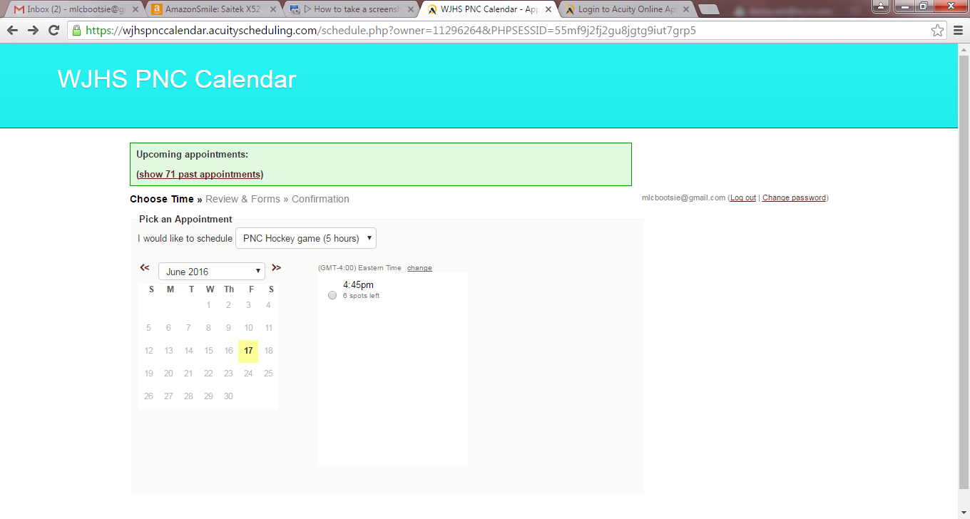
Available dates for the type event selected will be in BOLD
Select the date then click on the available time

Slide 11
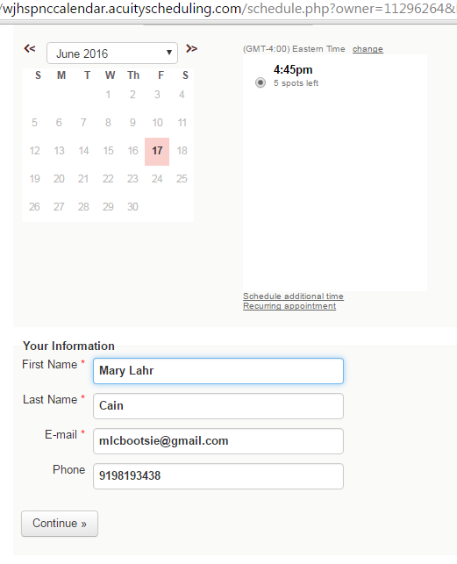
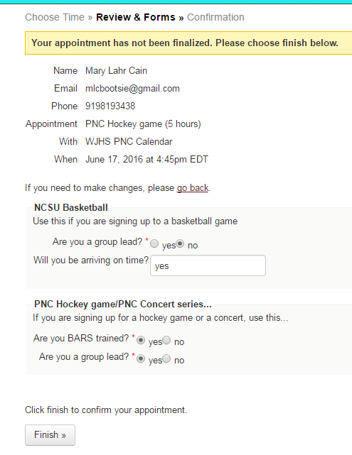
You must complete this screen and click on FINISH to schedule your volunteer time
Once you set up an account, your information will be filled in automatically

